Slide 1
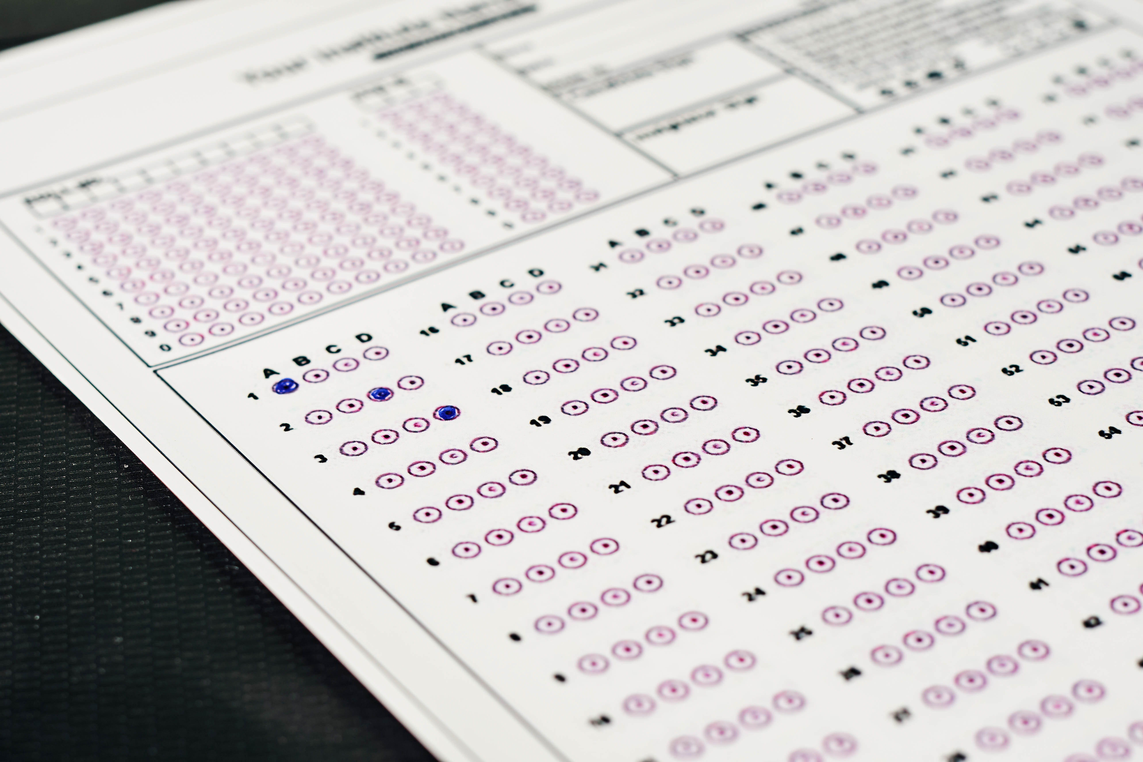
School District Testing Analysis (Mock dataset)
Josh Stephens
Hybrid Analyst
Creative Commons photo: https://www.flickr.com/photos/30478819@N08/51038121971
https://creativecommons.org/licenses/by/2.0/
Notes:
Thank you Mr. Toastmaster
I’m Josh Stephens, Hybrid Analyst for the District.
Thank you members of the school board for being here today for the presentation of this analytical project.

Slide 2
Overview
Purpose of project
District summary
Key observations
Success metrics
Recommended next steps
Notes:
First is a brief overview of what we’ll cover this morning.
After this meeting, the presentation along with the appendix and written analysis will be available.

Slide 3
Purpose
Analyze dataset
Summarize performance
Note observations
Make recommendations for further analysis

Slide 4
District Level Summary
Measure | Value
Total high schools | 15
Total students | 39,170
Total educational budget | $24.6mil
Average math score (max. 100) | 79
Average reading score (max. 100) | 82
% passing math | 75
% passing reading | 86
% passing both | 65
Notes:
Here you’ll see the district summary.
Scores for all 15 high schools were analyzed
Talk about what’s included in budget

Slide 5
Charter and traditional schools
Type | # | Avg # of students | Avg educational budget | Avg per pupil educational budget
Charter | 8 | 1,500 | $910,000 | $600
Traditional | 7 | 3,900 | $2,480,000 | $644
Total | 15 | 2,600 | $1,640,000 | $620
Notes:
Talk about difference between charter schools and traditional
https://www.usnews.com/education/k12/articles/understanding-charter-schools-vs-public-schools
-Our charter schools accept all students. If needed, random drawings are held to determine which students attend
-Our charter schools have more options and various models, more choice for parents
- More freedom, less board oversight and more accountable to parents
- Some of ours focus on specific things such as arts and science

Slide 6
Key observations
Our charter high schools had consistently higher scores than our traditional high schools
Our charter schools have lower per pupil educational budgets
Notes:
The charter schools high higher performance than traditional schools, with lower average budgets
During this presentation, I’d like you to keep these key observations in mind

Slide 7
Success Metrics
Math
Average score
% passing (≥ 70%)
Reading
Average score
% passing (≥ 70%)
Combined
% passing both
Notes:
Next, we’ll look at the various success metrics

Slide 8
Success Metrics
Performance by
spending
size
Additional details in Appendix
Notes:
We’ll also look briefly at average performance in a few different ways

Slide 9
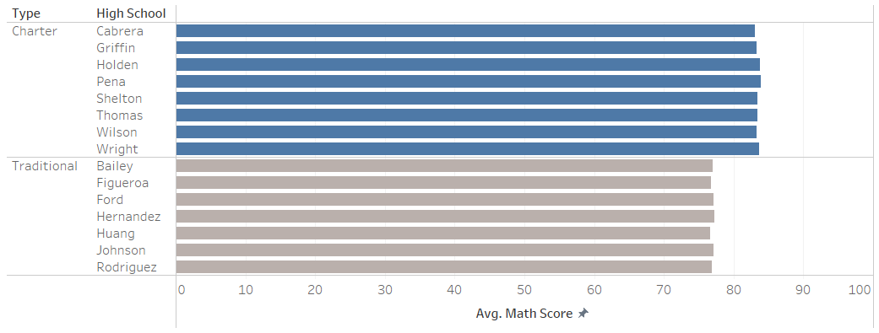
Average math scores
District average 79
Avg 83
Avg 77
Notes:
USE LASER POINTER TO HIGHLIGHT VARIANCE
SLOW DOWN AND LET AUDIENCE PROCESS
The overall average score for math was 79
At the top of the chart, you’ll see blue lines for each of the charter schools, which averaged 83
The gray bars at the bottom, show performance for each of the traditional schools, which average 77

Slide 10
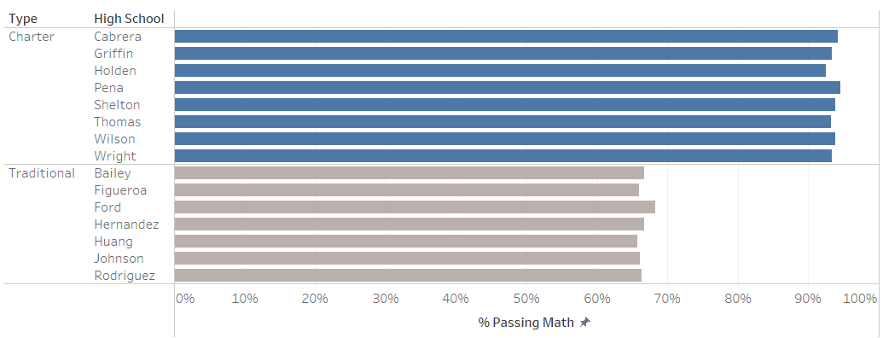
Percent passing math
District average 75%
Avg 94
Avg 67
Notes:
USE LASER POINTER TO HIGHLIGHT VARIANCE
SLOW DOWN AND LET AUDIENCE PROCESS
75% of district students passed the math exam.
The data show a significant difference between passing rates at charter schools, 94%, and traditional schools, 67%

Slide 11
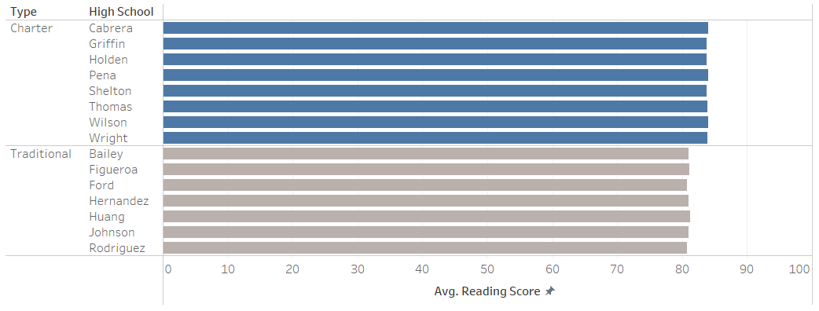
Average reading score
District average 82
Avg 84
Avg 81
Notes:
USE LASER POINTER TO HIGHLIGHT VARIANCE
SLOW DOWN AND LET AUDIENCE PROCESS
Average scores were higher for reading.
Note a similar difference in average scores between the two types of schools

Slide 12
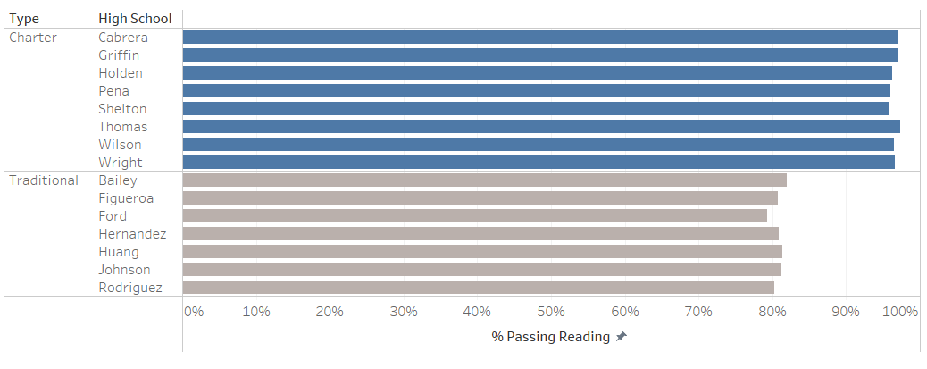
Percent passing reading
District average 86%
Avg 97
Avg 81
Notes:
More students passed reading
Again, the data show consistent differences between passing rates

Slide 13
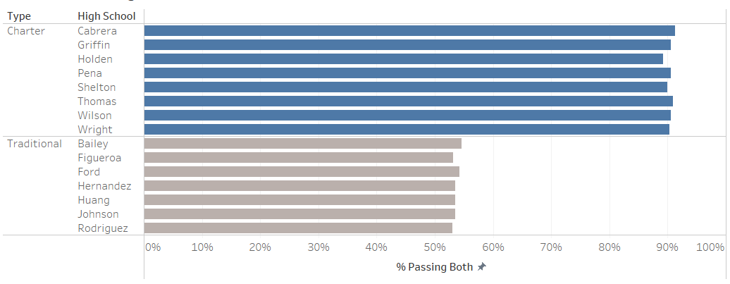
Percent passing both
District average 65%
Avg 90
Avg 54
Notes:
USE LASER POINTER TO HIGHLIGHT VARIANCE
SLOW DOWN AND LET AUDIENCE PROCESS
About two in three students passed both exams district wide
However, 9 in 10 passed in charter schools.
While 54% passed in traditional schools

Slide 14
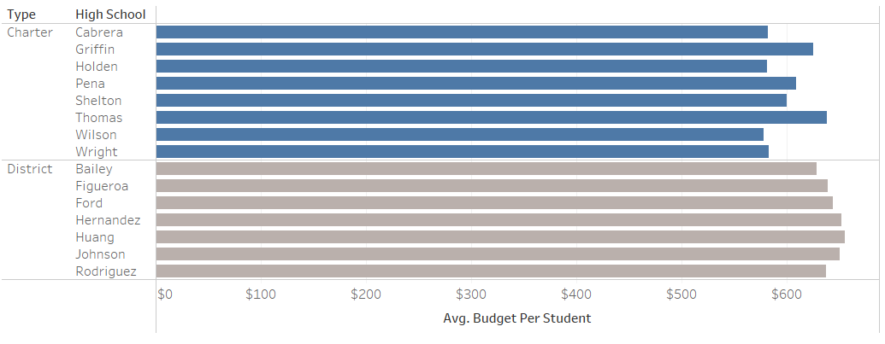
Educational budget per student
District average $629
Avg $599
Avg $643
Notes:
Here we see the per student budgets for each school
The charter schools averaged budgets that were about 7% lower than the traditional schools

Slide 15
Performance by school spending
Notes:
Here is the same data by school spending. Note that as the spending increases, the averages actually decrease
Call attention to the variance in % passing both

Slide 16
Performance by school size
Notes:
Now the data are by school sizes. As schools get larger, the averages decrease
Call attention to the variance in % passing both

Slide 17
Recommended Next Steps
Regression analysis
Are differences caused by other variables?
Team to study various approaches and make recommendations for future optimizations
Notes:
For recommended next steps,
We’d like to bring the traditional scores up to closer congruence with those of the charter schools
First I recommend that we perform a regression analysis to determine if the variances are a result of other variables or seem to be highly correlated to those mentioned in this presentation
Secondly, and in conjunction with the findings from the analysis, to have a team study various approaches that were used surrounding standardized testing in an attempt to socialize those that were highly effective

Slide 18
Closing
Purpose of project
District summary
Key observations
Success metrics
Recommended next steps
Notes:
First is a brief overview of what we’ll cover this morning.
After this meeting, the presentation along with the appendix and written analysis will be available.

Slide 19

Open floor for questions & observations
Photo by Nguyen Dang Hoang Nhu on Unsplash

Slide 20
Dataset Analyzed
Student file – 39,170 individual student records
Student ID
Name
Gender
Grade
High School
Reading score
Math score

Slide 21
Dataset Analyzed
School file -15 school records
School ID
Name
Type (charter or traditional)
Student population
Total budget

Slide 22
Analysis project
Aggregation of data to get success metrics
Joining of files to get type/school performance, budget summaries

Slide 23
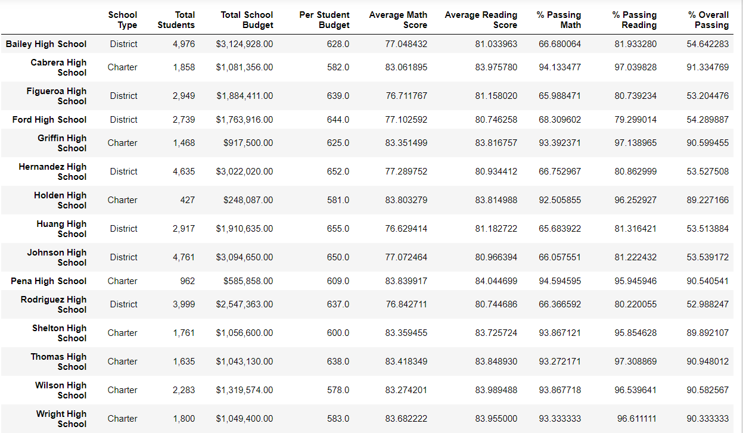
Individual school details

Slide 24
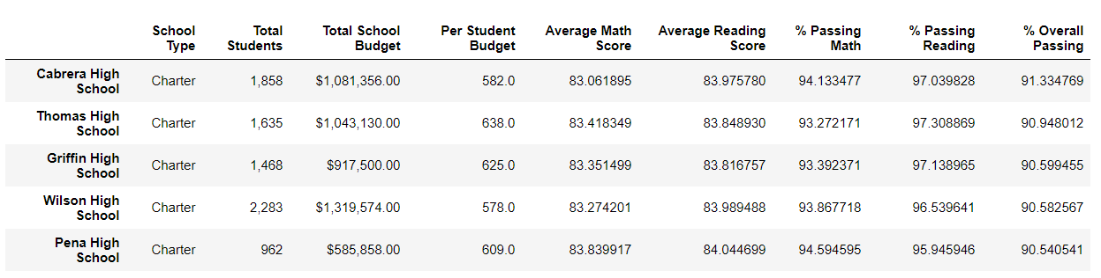
Top schools (overall % passing)

Slide 25
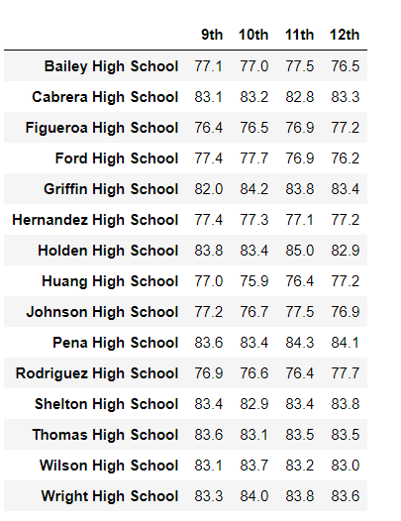
Math scores by grade

Slide 26
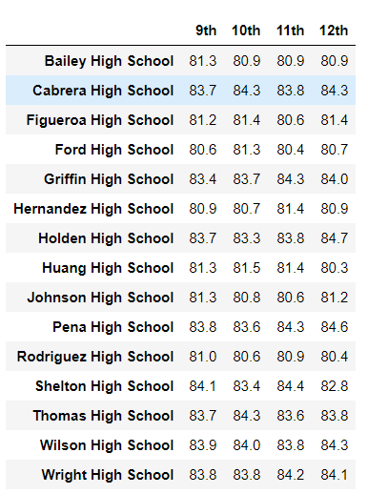
Reading scores by grade

